Slide 1
algorithms
David Kauchak CS 140 – Spring 2024

Slide 2
Introductions
Dr. | Prof | Professor
Dave | Kauchak
Pronouns: he/him/his

Slide 3
Meet your neighbors
What’s your name?
What year?
What has been your favorite CS class?
What’s been your least favorite CS class?
What do you hope to learn (or get out of) this class?

Slide 4
Algorithms
“For me, great algorithms are the poetry of computation. Just like verse, they can be terse, allusive, dense and even mysterious. But once unlocked, they cast a brilliant new light on some aspect of computing.” – Francis Sullivan
What is an algorithm?

Slide 5
Example algorithms
sort a list of numbers
find a route from one place to another (cars, packet routing, phone routing, ...)
find the longest common substring between two strings
add two numbers
microchip wiring/design (VLSI)
solve sudoku
cryptography
compression (file, audio, video)
spell checking
pagerank
classify a web page

Slide 6
Log properties
x = a^{b}
What is b?
b = log_{a} x

Slide 7
Log properties
log_{a} x x = a^{b}
a raised to what exponent is x?

Slide 8
Log properties
log_{a} a = ?
log_{a} x = ? if x > a
log_{a} x = ? if x < a
a raised to what exponent is x?
greater than 1 less than 1 exactly 1

Slide 9
Log properties
log_{a} a = 1
log_{a} x > 1 if x > a
log_{a} x < 1 if x < a
a raised to what exponent is x?
greater than 1 less than 1 exactly 1

Slide 10
Log properties
Which is bigger?
log₃ 2
log₄ 2

Slide 11
Log properties
Which is bigger?
log₃ 2 = x 2 = 3^{x}
log₄ 2 = x 2 = 4^{x}

Slide 12
Log properties
log (ab) = log a + log b
Which is bigger?
log₃ 27
log₄ 36

Slide 13
Log properties
log (ab) = log a + log b
Which is bigger?
log₃ 27 = log₃ 3 + log₃ 3 + log₃ 3
log₄ 36 = log₄ 4 + log₄ 3 + log₄ 3

Slide 14
Log properties
log (ab) = log a + log b
Which is bigger?
log₃ 27 = log₃ 3 + log₃ 3 + log₃ 3
log₄ 36 = log₄ 4 + log₄ 3 + log₄ 3
1
1
1
1
<1
<1

Slide 15
Log properties
log (a/b) = log a - log b
Which is bigger?
log₃ 4.5
log₄ 8

Slide 16
Log properties
log (a/b) = log a - log b
Which is bigger?
log₃ 4.5 = log₃ 9 – log₃ 2
log₄ 8 = log₄ 16 – log₄ 2

Slide 17
Log properties
log (a/b) = log a - log b
Which is bigger?
log₃ 4.5 = log₃ 9 – log₃ 2
log₄ 8 = log₄ 16 – log₄ 2
2
2

Slide 18
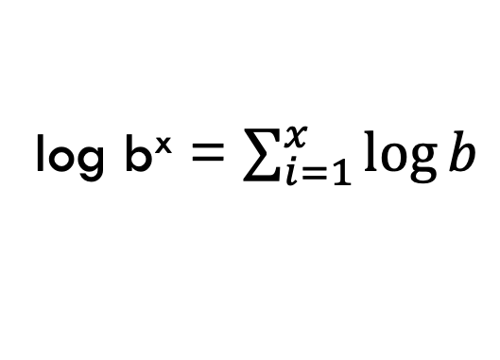
Log properties
log b^{x} = x log b
log b^{x} = log b + log b + … + log b
x times
log b^{x} = $\sum_{i=1}^{x}{\log{b}}$

Slide 19
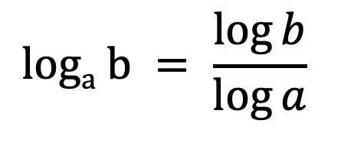
Log properties
$$loga b = \frac{\log{b}}{\log{a}}$$
allows you to change bases!

Slide 20
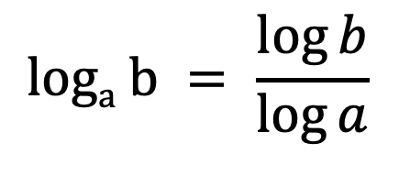

Log properties
$$loga b = \frac{\log{b}}{\log{a}}$$
log_{a} a = ?
log_{a} x = ? if x > a
log_{a} x = ? if x < a
$$loga x = \frac{\log{x}}{\log{a}}$$
greater than 1 less than 1 exactly 1

Slide 21
Log properties
$$loga b = \frac{\log{b}}{\log{a}}$$
log_{a} a = ?
log_{a} x > 1 if x > a
log_{a} x < 1 if x < a
$$loga x = \frac{\log{x}}{\log{a}}$$
greater than 1 less than 1 exactly 1

Slide 22
Log properties
$$loga b = \frac{\log{b}}{\log{a}}$$
Which is bigger?
log₃ 2
log₄ 2

Slide 23

Log properties
$$loga b = \frac{\log{b}}{\log{a}}$$
Which is bigger?
log₃ 2 = $\frac{\log{2}}{\log{3}}$
log₄ 2 = $\frac{\log{2}}{\log{4}}$

Slide 24
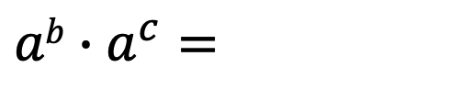
Exponent properties
$$ab∙a^{c}=$$

Slide 25
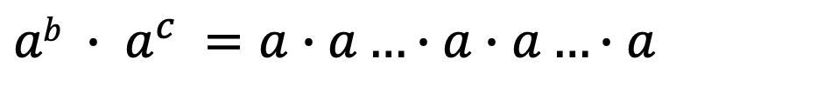
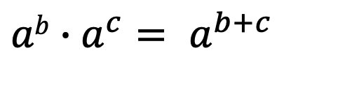
Exponent properties
$$ab∙a^{c}= a^{b+c}$$
$$ab ∙ a^{c} =a∙a…∙a∙a…∙a$$
b times
c times

Slide 26
Exponent properties
$$ab∙a^{c}= a^{b+c}$$
Which is bigger?
x²
x^{2.1}

Slide 27

Exponent properties
$$ab∙a^{c}= a^{b+c}$$
Which is bigger (x > 1)?
x²
$x^{2.1}={x2x}^{0.1}$

Slide 28

Exponent properties
$$ab∙a^{c}= a^{b+c}$$
Which is bigger (for x > 1)?
2^{x+1}
$2^{x}+2$

Slide 29

Exponent properties
$$ab∙a^{c}= a^{b+c}$$
Which is bigger (for x > 1)?
2^{x+1} = 2^{x} 2
$2^{x}+2$

Slide 30

Exponent properties
$$(ab)c =$$

Slide 31
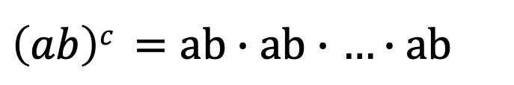
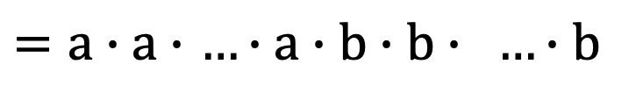
Exponent properties
$$(ab)c =acbc$$
$\left(ab\right)c =ab∙ab∙$ $…∙ab$
c times
$=a∙a∙$ $…∙a∙b∙b∙ …∙b$
c times
c times

Slide 32

Exponent properties
$$(ab)c =acbc$$
Which is bigger?
12³
4⁶

Slide 33

Exponent properties
$$(ab)c =acbc$$
Which is bigger?
12³ = (4*3)³ = 4³3³
4⁶ = 4³4³

Slide 34
Exponent properties
(a^{b})^{c} =

Slide 35
Exponent properties
(a^{b})^{c} = a^{bc}
$$\left(a^{b}\right)c =(a∙a∙…∙a)∙(a∙a∙…∙a)∙…∙(a∙a∙…∙a)$$
b times
b times
b times
c times

Slide 36
Exponent properties
(a^{b})^{c} = a^{bc}
Which is bigger (x > 1)?
2^{2x}
4^{x}

Slide 37
Exponent properties
(a^{b})^{c} = a^{bc}
Which is bigger (x > 1)?
2^{2x} = (2²)^{x} = 4^{x}
4^{x}

Slide 38
Pseudocode
A way to discuss how an algorithm works that is language agnostic and without being encumbered with actual implementation details.
Should give enough detail for a person to understand, analyze and implement the algorithm.

Slide 39
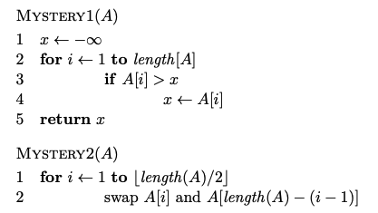
Pseudocode examples

Slide 40
Pseudocode convections
array indices start at 1 not 0
we may use notation such as ∞, which, when translated to
code, would be something like Integer.MAX VALUE
use shortcuts for simple function (e.g., swap) to make pseudocode simpler
we’ll often use ← instead of = to avoid ambiguity
indentation specifies scope

Slide 41
Proofs
What is a proof?
A deductive argument showing a statement is true based on previous knowledge (axioms)
Why are they important/useful?
Allows us to be sure that something is true
In algorithms: allow us to prove properties of algorithms

Slide 42
Proof techniques?
example/counterexample
enumeration
by cases
by inference (aka direct proof)
trivially
contrapositive
contradiction
induction (strong and weak)

